Slide 1
How to reconstruct a large genetic network from n gene perturbations in fewer than n ² easy steps
Andreas Wagner
Bioinformatics Vol. 17, no. 12,
pp. 1183-1197, 2001

Slide 2
Abstract
I present an algorithm to reconstruct direct regulatory interactions in gene networks from the effects of genetic perturbations on gene activity. Genomic technology has made feasible large-scale experiments that perturb the activity of many genes and then assess the effect of each individual perturbation on all other genes in an organism. Current experimental techniques can not distinguish between direct and indirect effects of a genetic perturbation.

Slide 3
Abstract
An example of an indirect effect is a gene X encoding a protein kinase, which phosphorylates and activates a transcription factor Y, which then activates transcription of gene Z. X influences the activity of gene Y directly, whereas it influences Z indirectly. To reconstruct a genetic network means to identify, for each gene and within the limits of experimental resolution, the direct effects of a perturbed gene on other genes.

Slide 4
Abstract
One can think of this as identifying the causal structure of the network. I introduce an algorithm that performs this task for networks of arbitrary size and complexity. It is based on a graph representation of a genetic network. Algorithmic complexity in both storage and time is low, less than O(n ²). In practice, the algorithm can reconstruct networks of several thousand genes in mere CPU seconds on a desktop workstation.

Slide 5
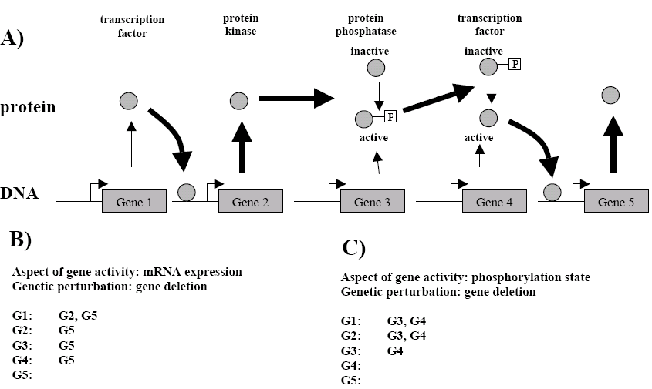
Genetic Network

Slide 6
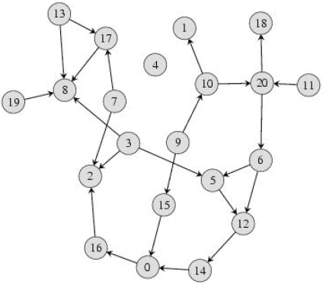
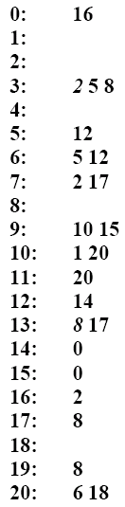
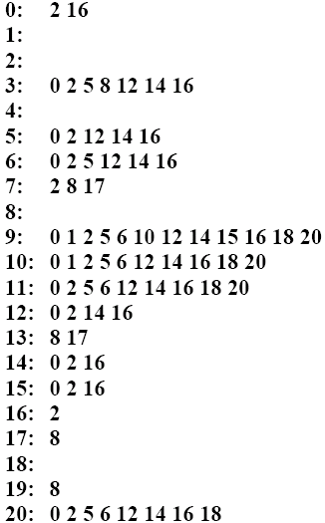
Genetic Network
Adjacency List
Accessibility List

Slide 7
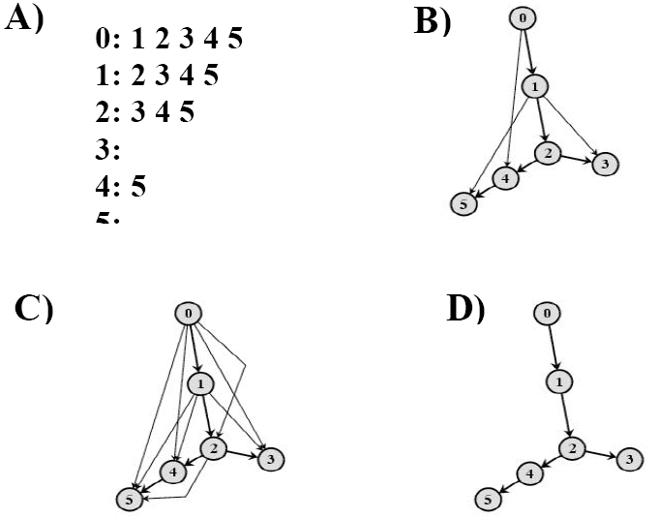
Network Reconstruction

Slide 8
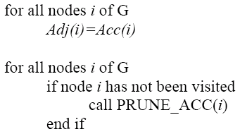
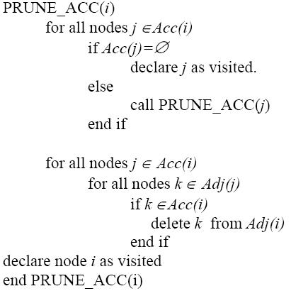
Network Reconstruction

Slide 9
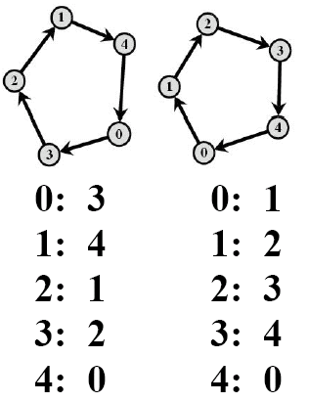
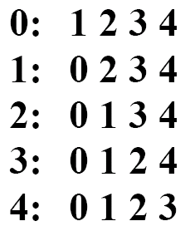
Cycles in Genetic Networks

Slide 10
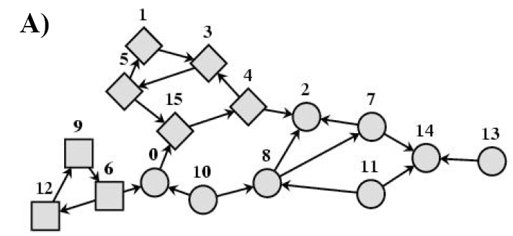
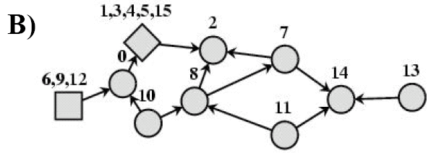
Cycle Reduction

Slide 11
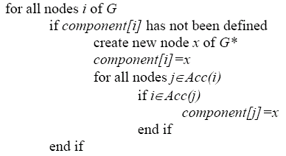
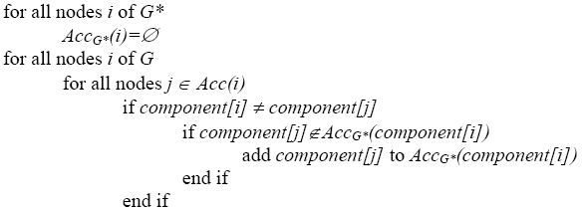
Cycle Reduction

Slide 12
Time Complexity
Reconstruction: O(nka)
  k : average number of entries in Acc. list.
  a : average number of entries in Adj. list.
  Large scale experimental gene perturbations in the yeast Saccharomyces cerevisiae (n=6300) suggests that k<50, a ≤ 1, and thus that nka << n ².
Cycle Reduction: O(nk)

